Slide 1
Raspberry Pi
Memory Organization, Ethernet and fun projects designed with this simple gadget

Slide 2
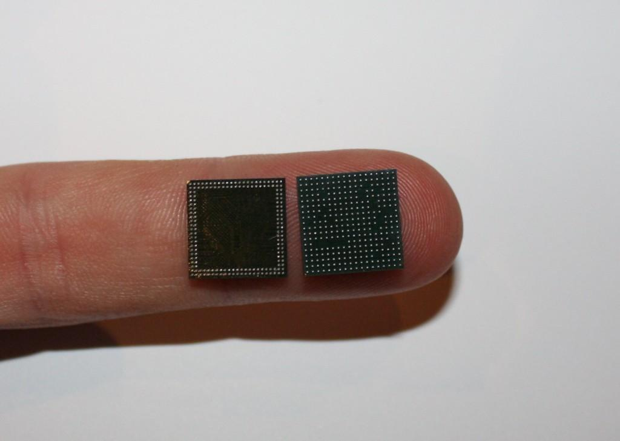
Model A & Model B
Differences in memory capacity:
Model A - 256MB SDRAM
Model B - 512MB SDRAM (as of 15
October 2012)
No extra memory can be added - the RAM is a POP package on top of the SoC

Slide 3
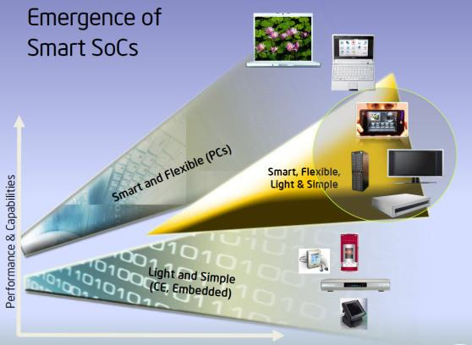
SoC vs Microprocessor
Microcontrollers typically have < 100KB RAM
A difference of degree and functionality
Microprocessor System on Chip

Slide 4
Memory split
What does it mean?
memory is shared between the CPU and GPU
What is the best split?
the universal answer - it depends
on the old beta B models - 128 for the CPU and 128 for the GPU
on the first 256MB release of model B 3 different splits were possible
on the new model B - any split
L2 cache is 128KB used primarily by the GPU

Slide 5
Persistant memory
No persistant internal memory
Consequences?
no BIOS
have to boot from SD card
cannot boot from anything but an SD card

Slide 6
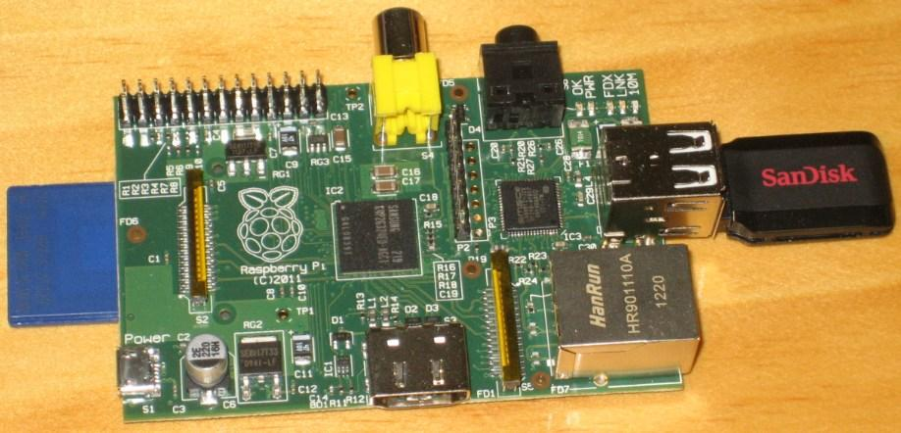
SD cards and storage

Slide 7
Networking and Wireless
Model B has 10/100 wired Ethernet
No Ethernet on model A
expected to be taken up by the education market
WiFi and Bluetooth available via USB dongle
No Gigabit Ethernet on either model

Slide 8
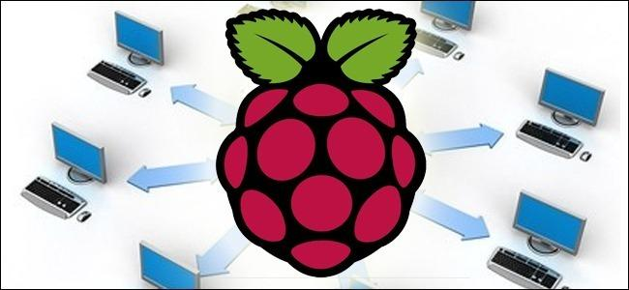
Low power network storage device
Why?
convenience: access your data at any time
really cheap: 5$ compared to a 200$ office server
How?
a RaspberryPi
external hard
drives

Slide 9
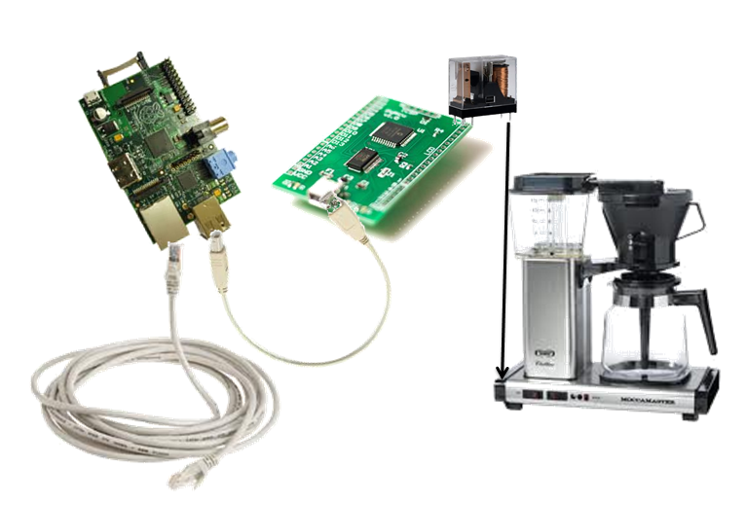
Other projects
MoccaPi

Slide 10
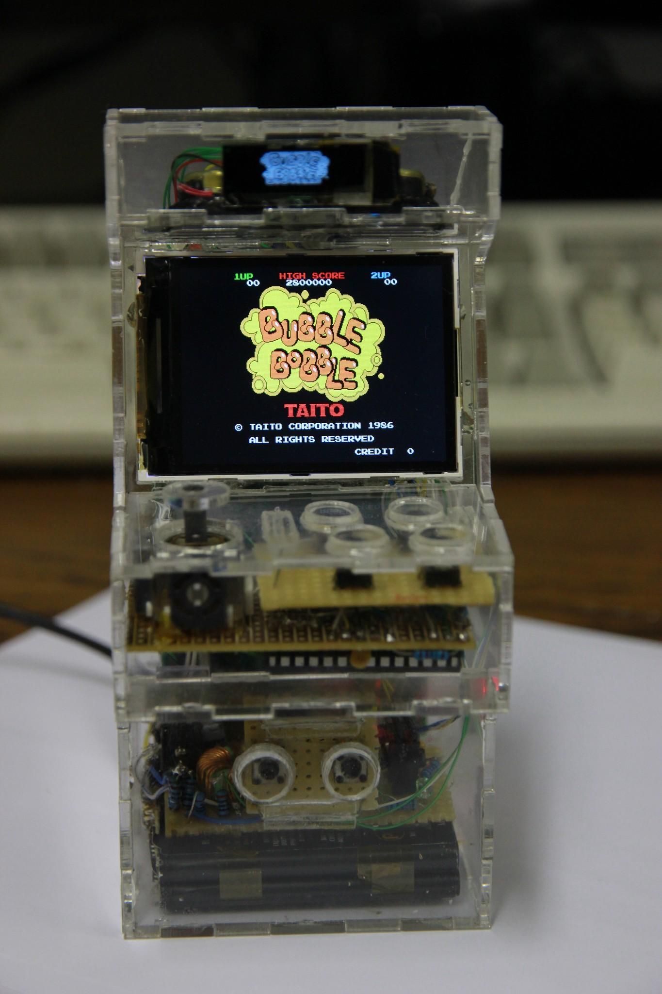
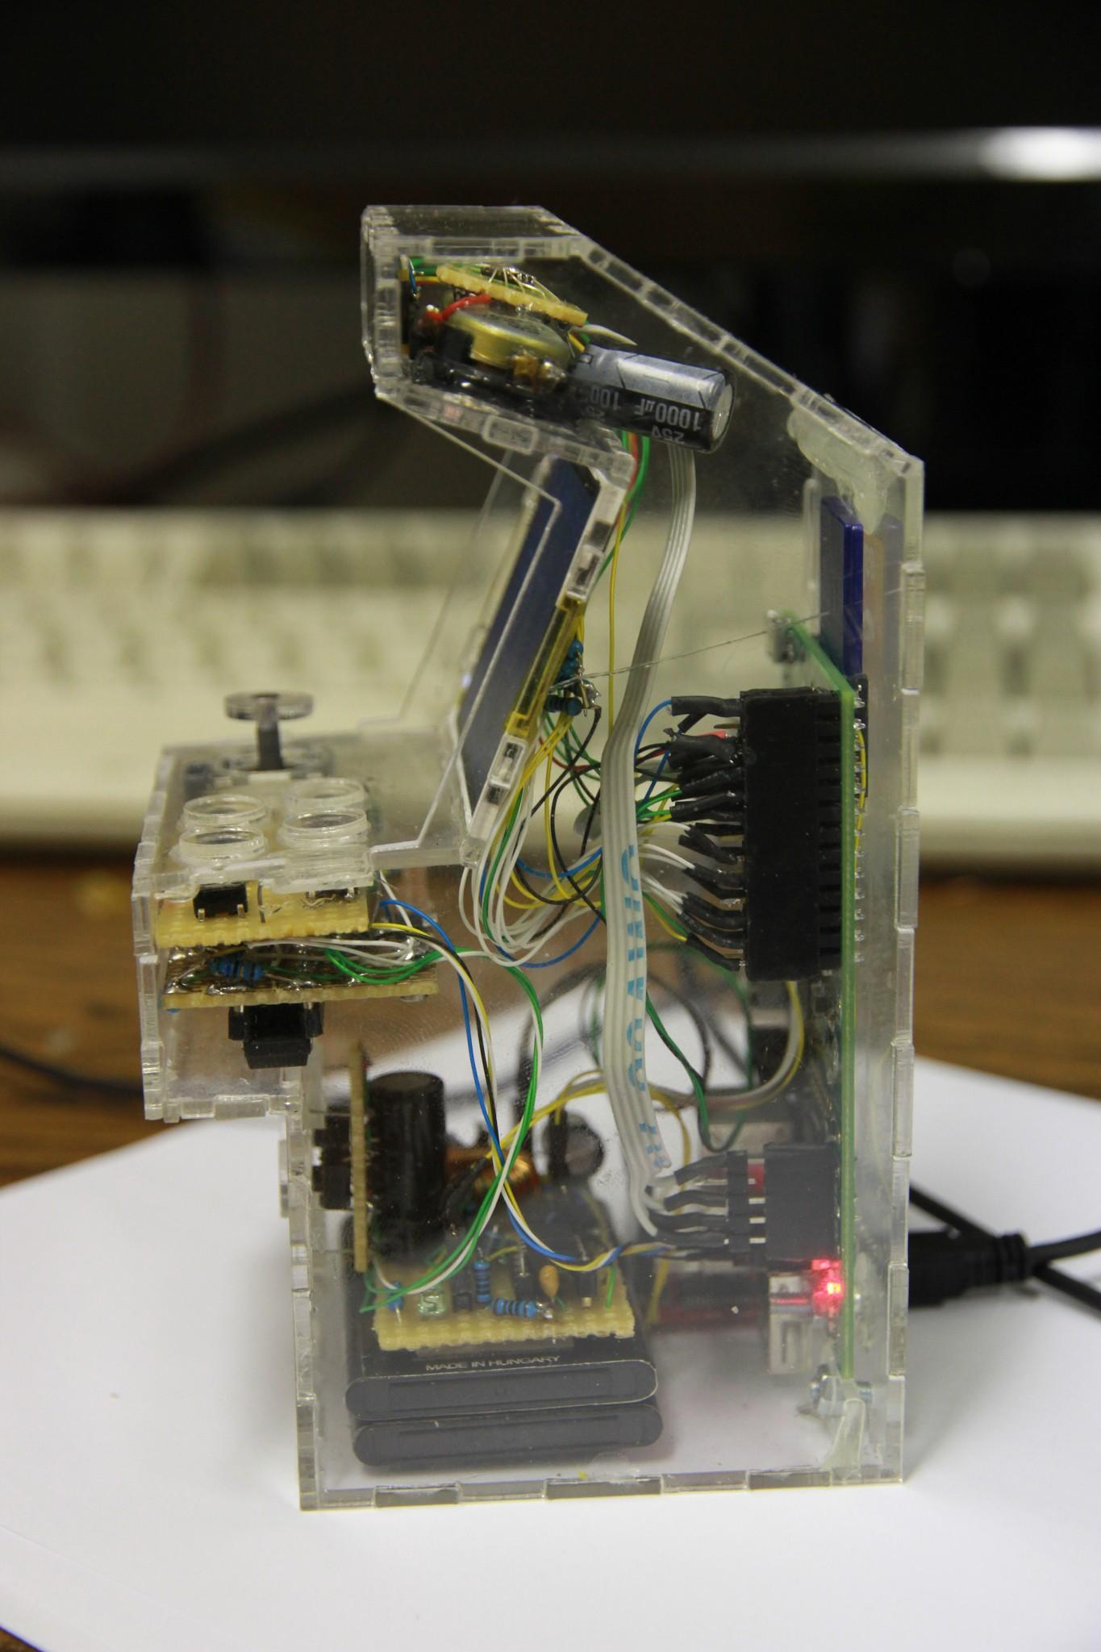
Other projects
Cool mini-arcade machine

Slide 11
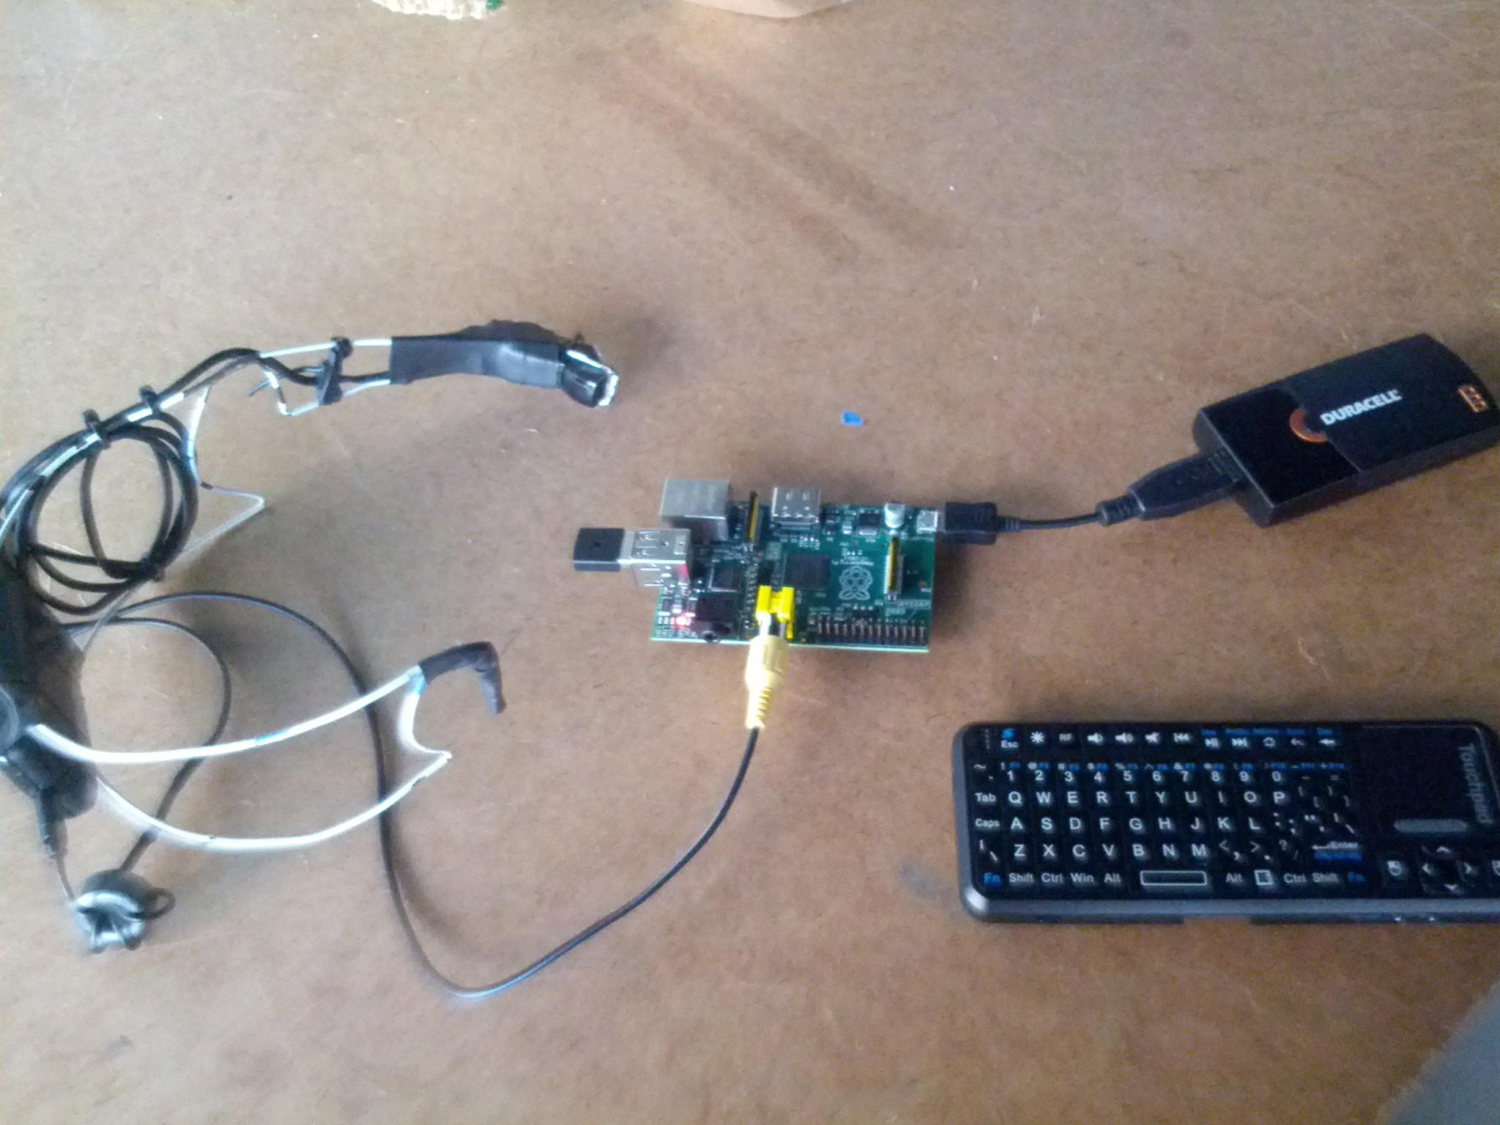
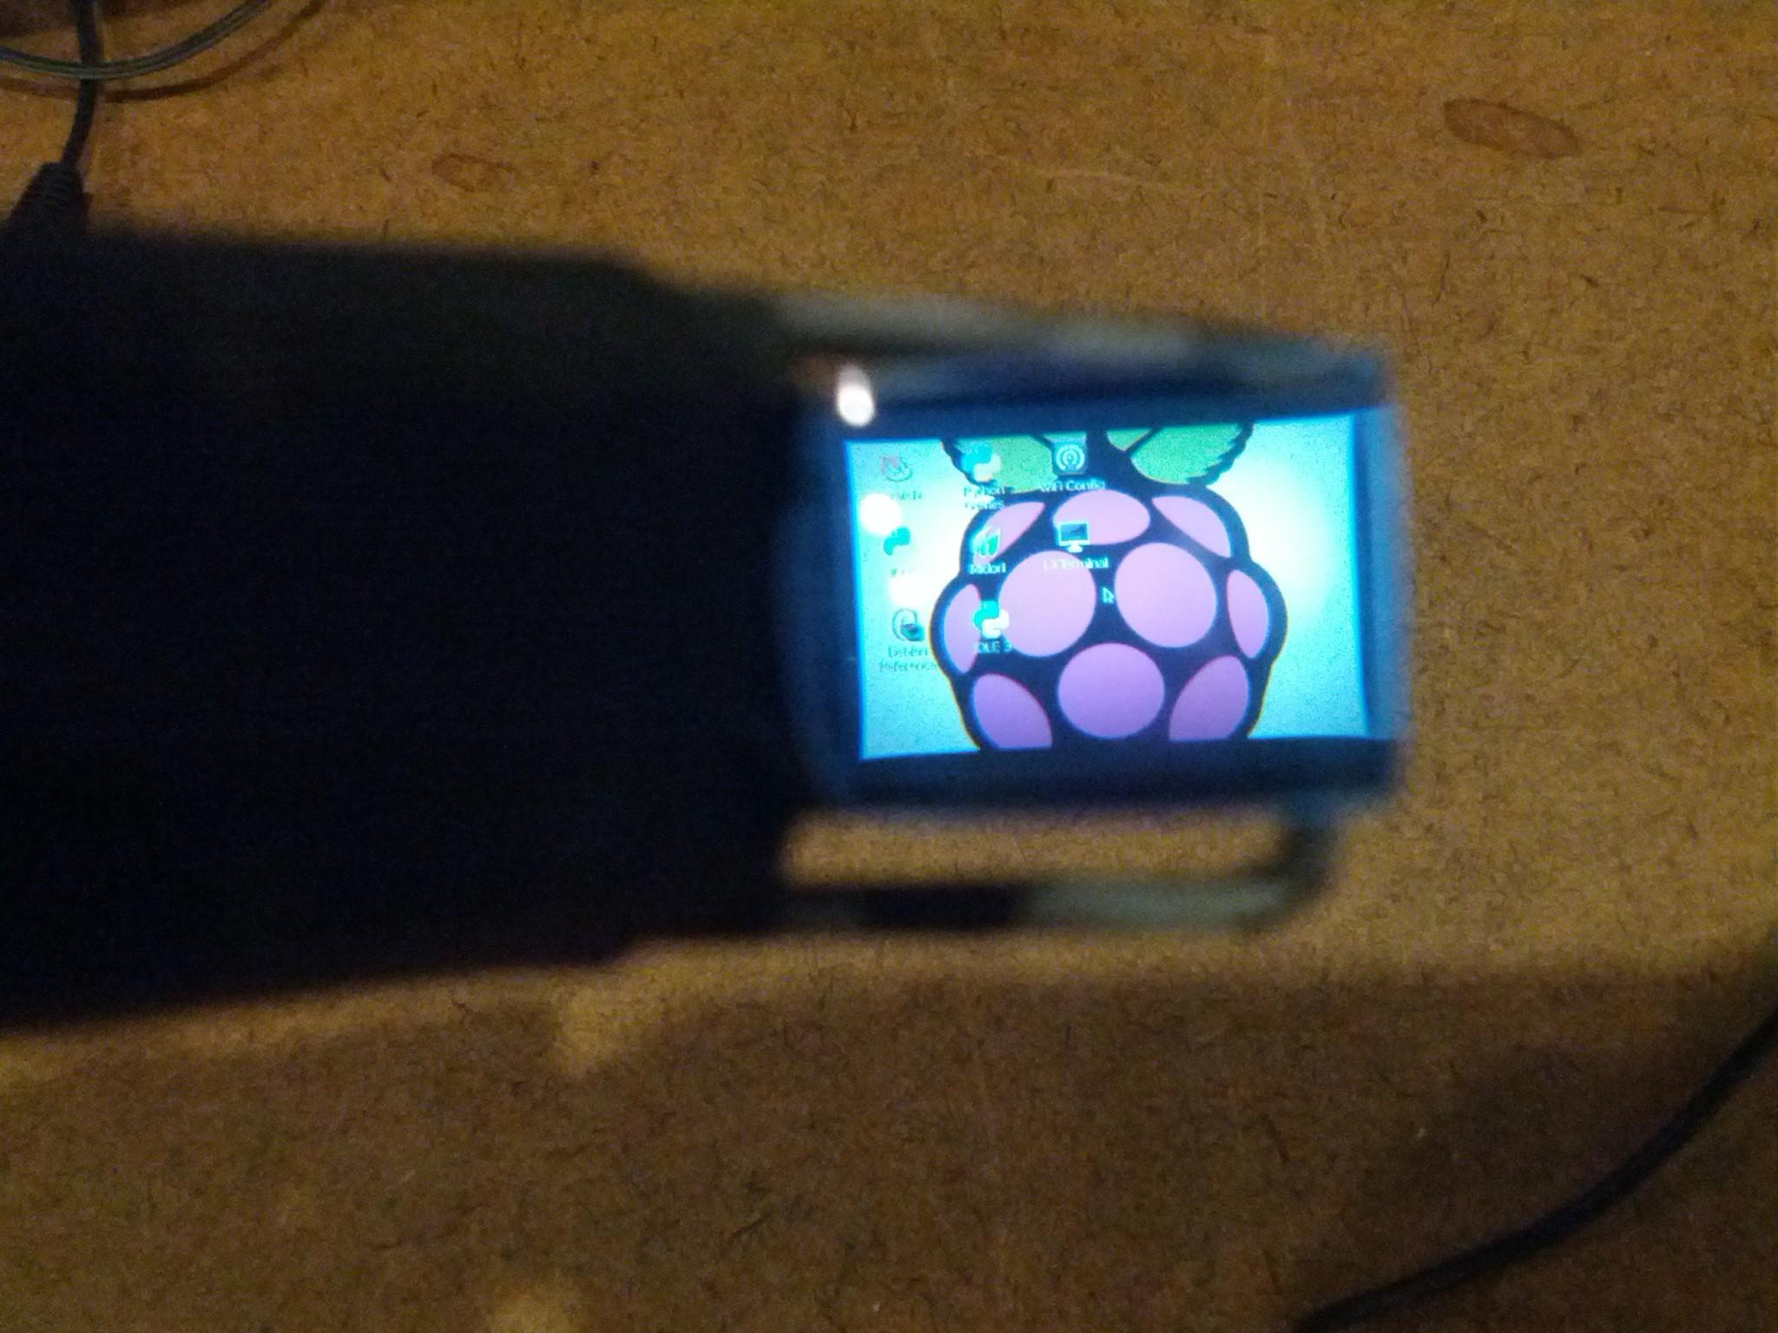
Other projects
Pi in the face

Slide 12
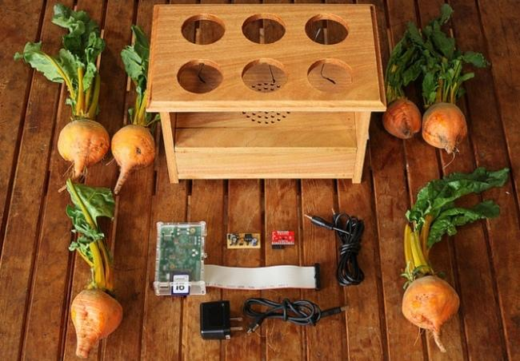

Other projects
BeetBox - http://scott.j38.net/interactive/beetbox/

Slide 13

Questions?

